Slide 1

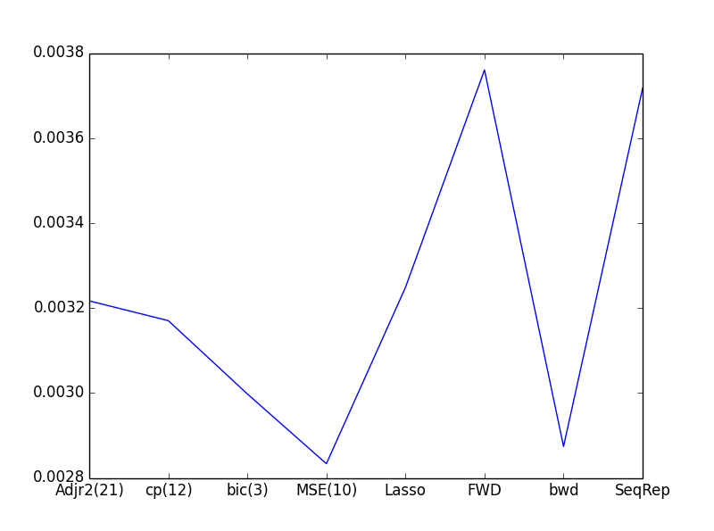
Predicting Baseball Wins
Kendall Bingham
Kim-Ndor Djimadoumnjar
Anthony Shipman
Picking a Fight With the Dreaded Curse of Dimensionality:
Original data set contained 72 predictors!
Using a combination of Best Subset Selection and Lasso, model reduced to 10 and 29 predictors respectively
10 Predictors from Best Subset Selection were:
Average Batter Age
Number of Players
Total Salary
4 Year Previous Record
6 Year Previous Record
Previous Year Home Run
Walks by Batter
Saves
Ballpark Hitter-Friendly Coef
Ballpark Pitcher-Friendly Coef
Resultant MSE:
Best Subset Selection: .002833395
Lasso: .003248297
Conclusions:
Team Age is best predictor of wins. Quadratic relationship. ‘Sweet spot’
Surprising usage 4 year and 6 year previous records
Hitter and Pitcher Ballpark Coefficients may be overly co-dependent

